Slide 1
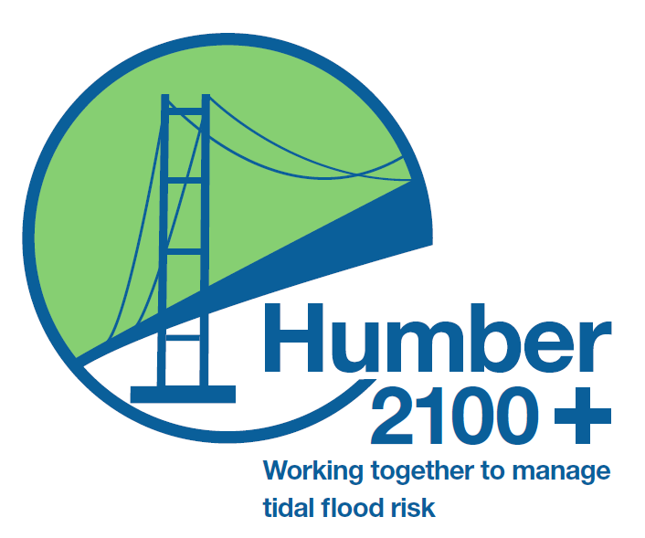
















Are you at risk of tidal flooding?
What matters to you where you live?
How will rising sea levels affect you?
The Humber2100+ partnership is working together to come up with a new approach to managing tidal flood risk around the Humber estuary and its tidal rivers
We want to find out what you think about tidal flooding and what matters to you where you live
Do you worry about climate change?
Do you live or work around the Humber?
What would you do if there was a flood?

Slide 2
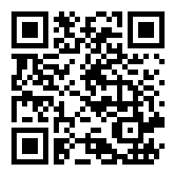


Take part in our survey
Visit https://www.smartsurvey.co.uk/s/HumberStrategySurvey/
scan the code, or find out more by visiting our information page https://consult.environment-agency.gov.uk/humber/strategyreview
and help us shape the way tidal flood risk is managed now and in the future
Find us on social media
@Humberstrategy
@Humber_Strategy

